Slide 1
ODE-RNN Based Flood Forecasting Model
By Karneedi Yasaswini Bala Aparna
21CE31008

Slide 2
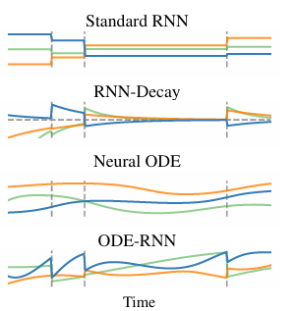
ODE-RNN:-
Generalizes RNNs to continuous-time dynamics using Ordinary Differential Equations (ODEs).
Captures hidden dynamics between irregularly spaced time steps.
Learns data-driven latent trajectories rather than fixed-step transitions.
Figure 1: Hidden state trajectories. Vertical lines show observation times. Lines show different dimensions of the hidden state. Standard RNNs have constant or undefined hidden states between observations. The RNN-Decay model has states which exponentially decay towards zero, and are updated at observations. States of Neural ODE follow a complex trajectory but are determined by the initial state. The ODE-RNN model has states which obey an ODE between observations, and are also updated at observations.

Slide 3
Why ODE-RNN for Flood Forecasting?
Because to overcome the problems with Traditional RNNs
Time series in flood prediction are often irregularly sampled (e.g., missing rainfall, delayed runoff).
Standard RNNs assume uniform time intervals so perform poorly on real-world flood data.
Preprocessing by imputing or aggregating destroys temporal information.
ODE-RNN handles missing data, varying sampling rates, and long-range dependencies better than RNNs.
Especially critical for forecasting inflow to dams like Hirakud, where sensors have asynchronous readings.

Slide 4

Background:-
To make RNNs to handle with irregular time steps, include time gap
in the update:
To define the hidden state h between observations. A simple alternative introduces an exponential decay of the hidden state towards zero when no observations are made.
τ is a decay rate parameter.

Slide 5

Neural Ordinary Differential Equations (Neural ODEs):-
Treat hidden state as a continuous-time trajectory:
fθ: neural network defining ODE dynamics
h(t) is solved using ODE solvers:
Numerical ODE Solvers Allows for:
Memory-efficient training via adjoint sensitivity.
Easy extension to larger models.
Flexible modeling of time-dependent dynamics.

Slide 6
Data :
We have rainfall(3050 entries) and runoff data(3045 entries), across 158 stations.
We also have discharge data(3050 entries) from 12 stations, and also from the Hirakud dam.
The features used in the model are the mean values of rainfall, runoff, and discharge (excluding Hirakud).
The target variable is the Hirakud Inflow, measured in cubic meters per second (m³/s).

Slide 7
Data Preprocessing:
Prepare input features(mean_rainfall, mean_runoff, and mean_discharge (excluding Hirakud)) for a ODE-RNN model from hydrological time series.
First 5 days of rainfall data were removed(because of antecedent Condition)
Min-Max Scaling is used to normalize features between 0 and 1.
80% training and 20% testing (no shuffling to preserve temporal order).
Used sliding window to create 10-time-step sequences for temporal learning.

Slide 8
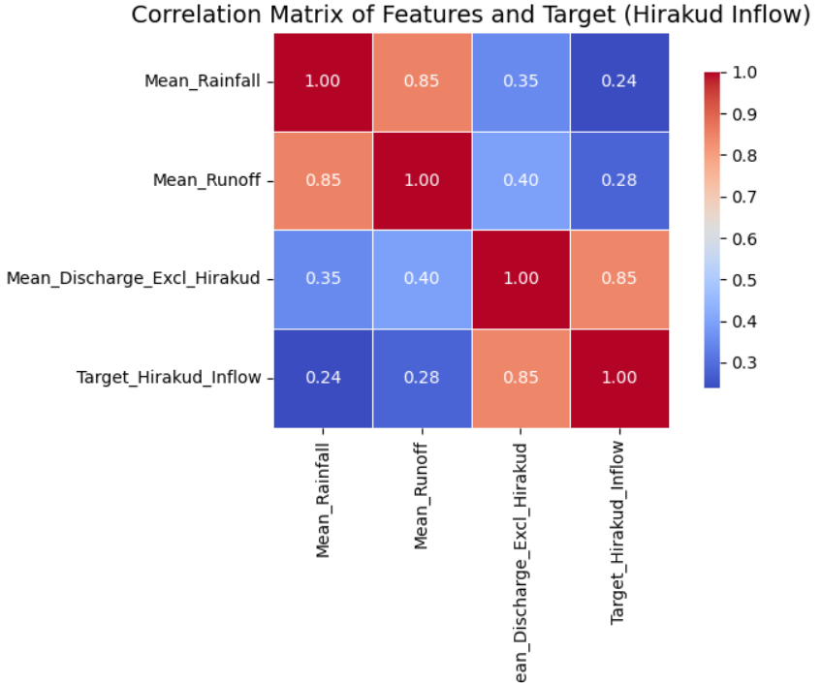
Correlation Matrix of Features and Target (Hirakud Inflow):-
Mean_Discharge_Excl_Hirakud has the strongest correlation (0.85) with the Target_Hirakud_Inflow, indicating it is a critical predictor.
Mean_Runoff shows moderate correlation with the target (0.28), while Mean_Rainfall has a lower correlation (0.24).
Mean_Rainfall and Mean_Runoff are highly correlated (0.85), suggesting potential multicollinearity.

Slide 9
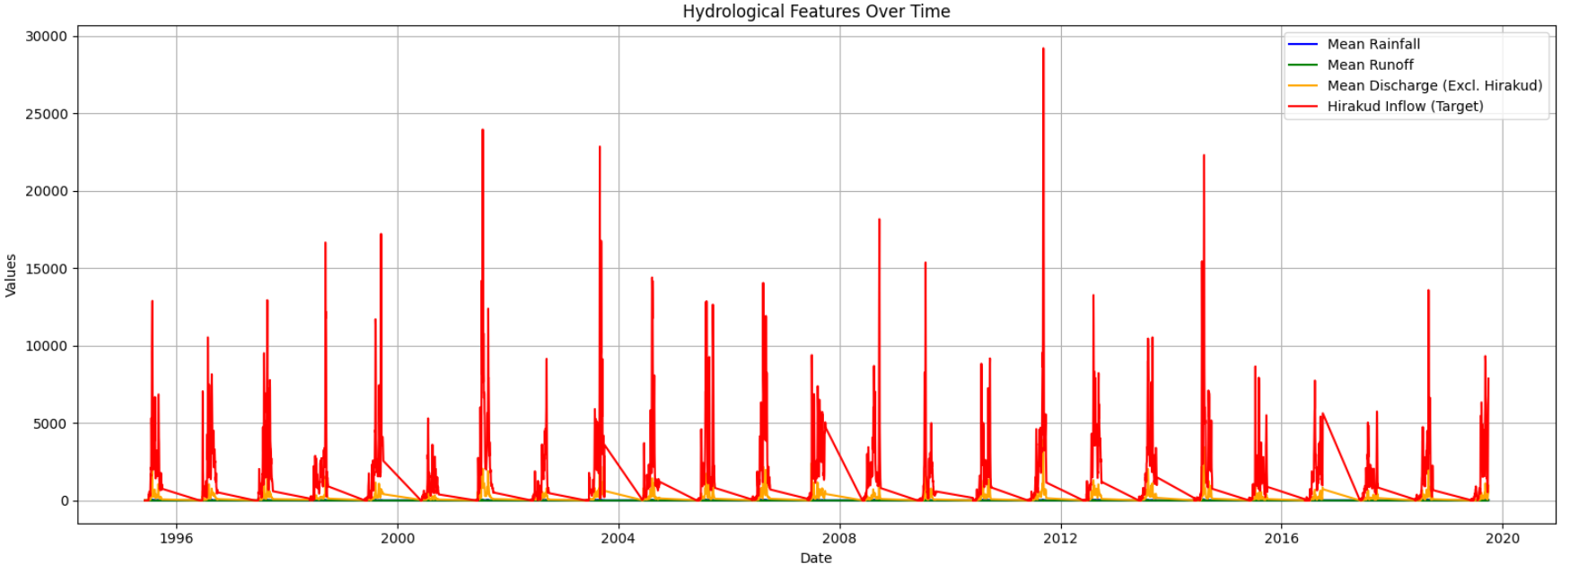
Time Series Analysis:-
The plot illustrates temporal trends of Mean Rainfall, Mean Runoff, Mean Discharge (excluding Hirakud) and Target Hirakud Inflow

Slide 10
Hirakud inflow (red) shows sharp spikes during monsoon periods likely due to intense rainfall events.
Mean Rainfall (blue) and Runoff (green) exhibit seasonal variability with moderate peaks.
Mean Discharge excluding Hirakud (orange) aligns with general runoff patterns, showing response delays to rainfall.
The inflow to Hirakud reservoir is highly dynamic and strongly influenced by upstream rainfall and runoff.
This plot justifies the need for time series forecasting models (e.g., ODE-RNN) that can capture sequential dependencies.

Slide 11

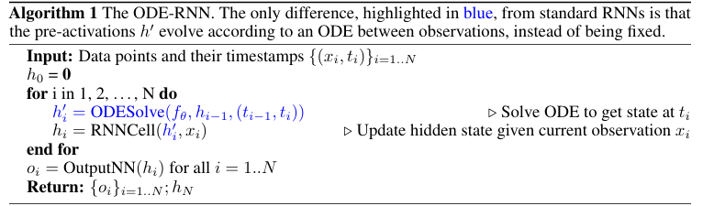
Constructing the ODE-RNN Hybrid:-
Standard RNNs with exponential decay approximate:
But this assumes fixed decay so not flexible enough.
ODE-RNN replaces this with a learned ODE dynamic using a neural network fθ
with solution:

Slide 12
Autoregressive Forecasting with ODE-RNN:-
Given time series, model joint distribution:
ODE-RNN can be used to predict flood variables (e.g., inflow) at future timesteps using past data.
Latent ODEs: a Latent-variable Construction
Autoregressive models (like ODE-RNN) are Easy to train and Great for dense data
But Hard to interpret and Do not explicitly capture uncertainty about hidden states

Slide 13


Latent ODEs :Generative Modeling with Uncertainty
Latent ODEs assume a latent variable z0 generates the entire trajectory:
We use ODE-RNN encoder for irregular time series
Variational Inference with ODE-RNN Encoder:-
To estimate posterior
g: neural network projecting final encoder state to mean & variance
Run encoder backwards from tN to t0 for posterior estimation

Slide 14
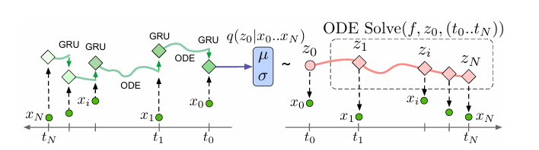
Figure 2: The Latent ODE model with an ODE-RNN encoder. To make predictions in this model, the ODE-RNN encoder is run backwards in time to produce an approximate posterior over the initial state: . Given a sample of z0, we can find the latent state at any point of interest by solving an ODE initial-value problem.

Slide 15
Latent ODEs model dynamics via, generating the full trajectory using an ODE.
The model is trained by maximizing the Evidence Lower Bound (ELBO):
This decouples System dynamics (via ODE), Observation process, Recognition model
Enables Uncertainty quantification, Backward-in-time prediction, Conditioning on partial data

Slide 16

3.3 Poisson process likelihoods:-
In real systems, when a measurement at a particular time is often informative about the state of the system then Latent ODEs can model this with an inhomogeneous Poisson process using:
λ(t): intensity of event rate, modeled as a function of latent state
Modeling observation time with Poisson likelihood enhances data efficiency and early warning capability.
Especially useful when integrating real-time telemetry with continuous latent dynamics.

Slide 17
Batching and Computational Complexity in ODE Models:-
In a minibatch, each time series can have different observation times.
To compute ODE solutions in parallel, we must solve at the union of all time points in the batch.
Adaptive ODE solvers are not sensitive to the number of output time points.
Runtime is governed by Total time span [t1,tN] and Complexity of the underlying dynamics.
ODE-RNNs and Latent ODEs have a similar asymptotic time complexity to standard RNN models.
In our experiments, we found that the ODE-RNN takes 60% more time than the standard GRU to evaluate, and the Latent ODE required roughly twice the amount of time to evaluate than the ODE-RNN.

Slide 18
When to Use ODE-based Models over Standard RNNs?
Limitations of Standard RNNs:
Ignore time gaps between observations.
Perform well only on regularly spaced data with minimal missing values.
Advantages of ODE-based Models (e.g., ODE-RNN, RNN-Decay):
Support continuous-time latent states.
Enable evaluation at any time point and suitable for interpolation.
Future states depend on elapsed time since last observation.
Better suited for sparse or irregular data.

Slide 19
RNN-Decay Limitation:
Forces hidden state to decay toward a fixed point.
May miss complex time-varying dynamics.
ODE-RNN Advantage:
Learns the dynamics between observations.
Does not require predefined decay behavior.
Works well without strong assumptions about data dynamics.

Slide 20
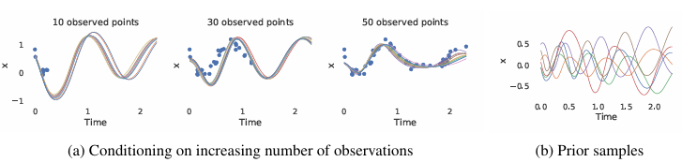
Experiments:-
4.1 Toy dataset:-
Objective is to Evaluate Latent ODE’s capability on periodic data.
Dataset has 1,000 trajectories with variable frequency & same amplitude. Each trajectory has 100 irregularly sampled points. Gaussian noise is added to make the problem non-trivial
(a) A Latent ODE model conditioned on a small subset of points. This model, trained on exactly 30 observations per time series, still correctly extrapolates when more observations are provided.
(b) Trajectories sampled from the prior p(z0) ∼ Normal( z0;0,I) of the trained model, then decoded into observation space.

Slide 21
Latent ODE – Conditioning on Sparse Data:-
Latent ODEs reconstruct trajectories well with very few observed points.
Trained on 30 points per trajectory.
Tested on 10, 30, 50 points – quality improves with more data.
More observed points then better fit and lower variance.
Samples from prior show model learns periodicity implicitly.

Slide 22
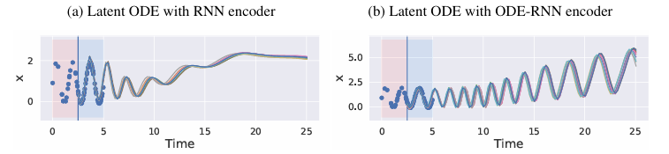
Extrapolation of Latent ODE vs ODE-RNN:-
Trained on [0, 2.5]; evaluated on [2.5, 5] for extrapolation.
Results :
Latent ODE with ODE-RNN encoder Maintains periodicity and extrapolates well.
Latent ODE with RNN encoder Fails to extrapolate periodic dynamics.
So, ODE-RNN encoder better captures long-term temporal dynamics.

Slide 23
Applications of ODE-RNN:-
Environmental and Hydrological Forecasting
Healthcare Time Series
Financial Time Series Forecasting
Autonomous Systems
Neuroscience & Cognitive Modeling
Physics-Informed Modeling

Slide 24
Advantages of ODE-RNN:-
Handles Irregularly Sampled Data
Continuous-Time Latent Dynamics
Robust to Missing Data
Physics-Inspired Interpretability
Plug-and-Play with Existing RNN Architectures
Parameter Efficiency
Limitations of ODE-RNN:-
Computational Overhead
Sensitivity to Solver Settings
Gradient Backpropagation Challenges
Struggles with Discrete Events
Complex Implementation

Slide 25
Summary of ODE-RNN:
Ideal for hydrological data because it models temporal evolution of rainfall-runoff-discharge effectively.
Handles missing or irregularly sampled data and learns non-linear system dynamics better than traditional models.
Better generalization across flood events and supports early warning systems by forecasting with limited past observations.
Promising results in terms of RMSE, NSE, and peak detection accuracy.

Slide 26
THANK YOU!!

